Slide 1

Promoting integrated rural-urban development as structural transformation evolves
Christopher B. Barrett
Cornell University
Seminar to Development Research Center of the State Council
Beijing, China
October 2025

Slide 2
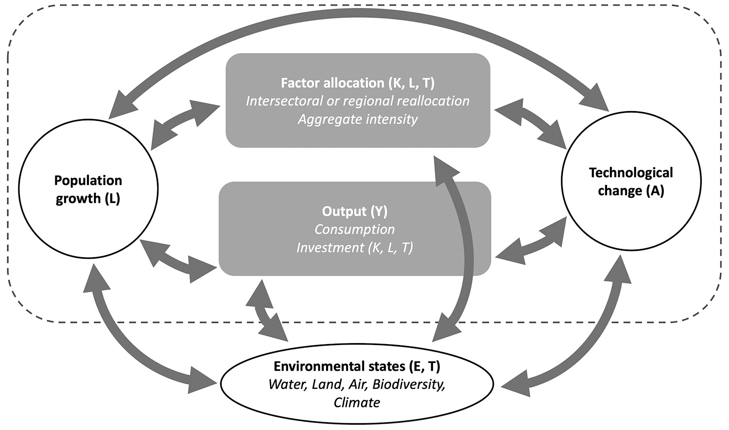
Structural transformation
Evolving narratives of structural transformation
1950s-90s view: Ag tech change frees farm labor and boosts demand for nonfood products. City-based industry grows while real food prices fall.
More recent view: As economies open, non-ag tech change boosts demand and draws labor from ag, driving up K/L on farm. Induced environmental change slows transformation and accelerates real food price rise.
Source: Barrett et al. REEP 2023

Slide 3

Rural non-farm economy
Structural transformation
Agricultural growth helps drive rural non-farm expansion,
which generates rapid poverty reduction.
“[M]igration out of agriculture into the missing middle (rural nonfarm economy and secondary towns) yields more inclusive growth patterns and faster poverty reduction than agglomeration in mega cities.” - Christiaensen & Todo (2014 World Development)

Slide 4

Structural transformation
Rural non-farm economy
Technologies to reduce transactions costs and enhance financial access accelerate transformation.
“the spread of mobile money helped raise at least 194,000 households out of extreme poverty, and induced 185,000 women to switch into business or retail as their main occupation.” – Suri & Jack 2016 Science

Slide 5
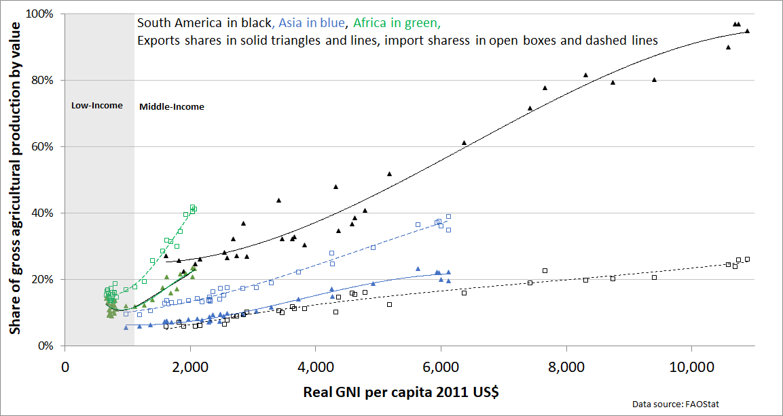
Structural transformation
African ag tech change
Value chains are mainly domestic but steadily becomes more global as TFP and incomes rise and trade costs fall. Richer consumers demand more variety, stability. Low value/weight and perishability mean domestic market opportunities >> int’l trade. Globally, only 25-30% of food production is traded internationally. In low-income range, gross exports/imports consistently <20% of production.
Barrett et al. J. Econ. Lit. 2022

Slide 6
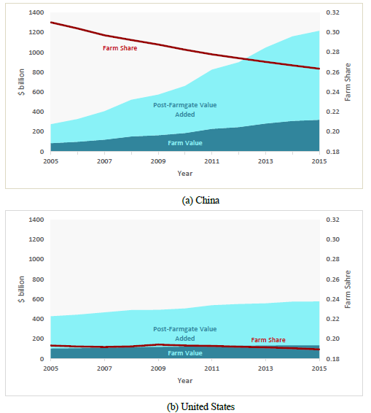
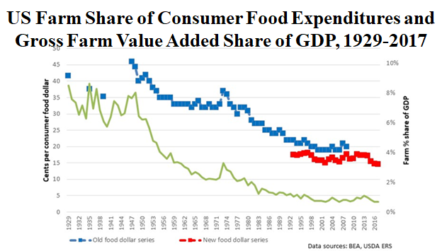
Value chain transformation
Structural transformation and market integration push food value addition downstream, post-farmgate.
Source: Barrett et al. JEL 2022
Food, tobacco, agriculture and forestry at home expenditures in the United States and China. Does not include away from home expenditures. The left axis in billion current US$, right axis shows the percent farm share of total food, tobacco, agriculture and forestry at home expenditures (red line). (Source: Yi et al. Nature Food 2021)

Slide 7
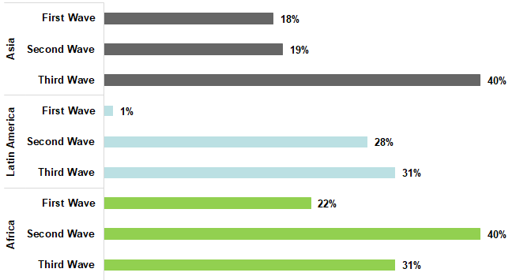
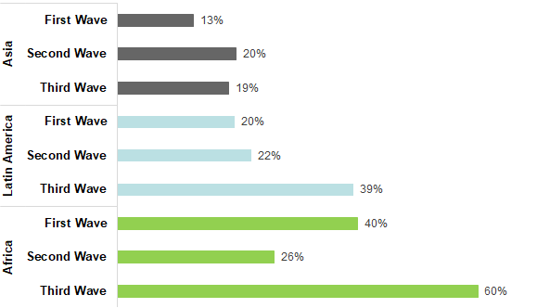
Value chain transformation
Generates rapid expansion in downstream value addition in food systems, esp. consumer-facing
Multinational food service chains real annual sales growth, 2008-2018
Leading grocery chains’ edible sales, average real annual growth, 2002-18
Barrett et al. JEL 2022

Slide 8
The challenge
As agricultural share of employment and GDP falls, and especially if real food prices are falling, leaders start ignoring ag other than as a political constituency. So producer payments/subsidies begin replacing R&D.
Result: slowing supply growth – aggravated by env’t degradation – with still-rising demand growth. Result: rapid real prices rises.
Has serious distributional consequences b/c most poor are net food buyers and food has large budget share.
Aggravates rural-urban disparities.

Slide 9
Ag R&D for integrated rural-urban development
Ag “technology treadmill” and gains from change
Naïve model
If demand is perfectly elastic, gains accrue to producers.
But when, if ever, does this really happen?
Small-scale change: early adopters (who?)
Perfect market integration … export surplus production
New Supply
Price
Original Supply
Demand
P
Producer
Surplus
Added Producer
Surplus
Quantity

Slide 10
Ag R&D for integrated rural-urban development
“Technology treadmill” and gains from change
Big winners from most ag tech change are typically consumers not producers. Why?
Price
More realistic model
Price inelastic demand.
Fallacy of composition: what’s true at small scale (tech. change profitable for first few adopters) not true at large scale.
Hence tech treadmill.
Demand
New Supply
Original Supply
Consumer
Surplus
P ^{old}
Old Producer
Surplus
New Consumer
Surplus
P ^{new}
New Producer
Surplus
Quantity

Slide 11
Who gains and why?
So how does ag tech change matter?
Increase farm profits, at least for early adopters: Those with best access to ICT, extension, credit/insurance, input and output markets, etc. These farmers gain from yield increases, cost reductions, or both.
Boost rural labor demand: Rural poor typically work off-farm (at least part-time). Enjoy labor market gains, both through more hours worked and higher real wages.
Reduce food prices: If enough adoption, aggregate supply shifts and prices fall (by how much depends on integration with national and global markets). Poor usually net food consumers who gain.
Result: Broad-based but uneven and evolving gains

Slide 12
Implications
Key policy implications
R&D financing
Need public R&D to keep farm costs and food prices down and accelerate innovation.
Use benevolent patent extensions to induce private investment using market mechanisms. (Barrett Nature 2023)
Promote rural value addition and waste re-use
Use rural renewable energy generation and transport to do initial post-harvest processing in secondary towns/cities.
Need R&D and regulation to produce healthy, affordable products and re-use processing wastes (feed, fertilizers, fuel).

Slide 13
Implications
Key policy implications
Work with private sector to stimulate faster change
Far fewer decision-makers.
Extension
Essential to complement discovery and diffuse innovations faster and more equitably.
Accelerate pace by integrating research/extension well.
Science and Technology Backyards seems a great model!

Slide 14
Structural transformation
Back to the future, but differently!
Reinvest in ag tech change. With better ICT/transport and falling population, this dampens food price rises and food imports (+ boosts exports) and helps stem environmental degradation, thereby supporting nonfarm labor productivity.
But now:
Focus on reducing land, water and chemicals use and GHG emissions as was to boost output and farm profits.
Diversify farmers’ income through renewable energy, payments for environmental services, and tourism.
Develop ‘de-agrarianized’ food production in peri-urban spaces.
Promote secondary cities for off-farm food production and processing, drawing on renewable energy.
Need for safety nets and skills retraining to support workforce transition.

Slide 15
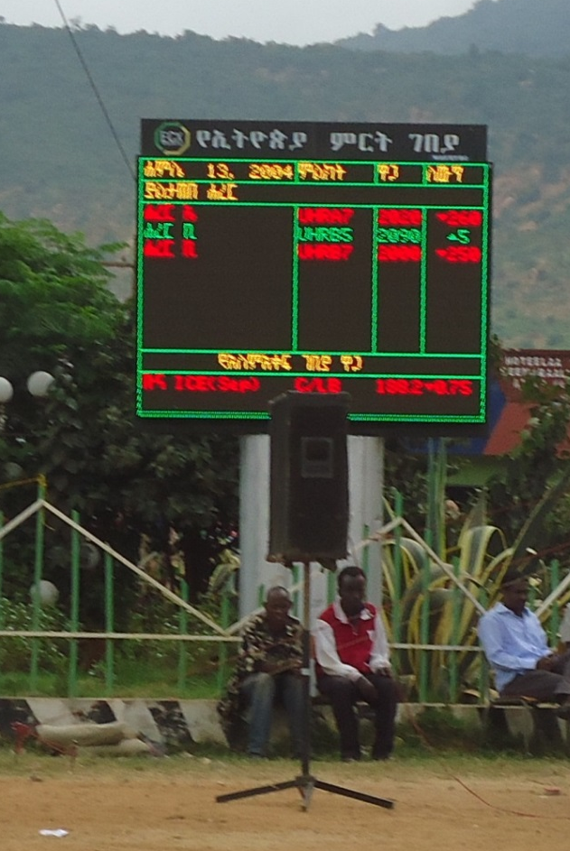
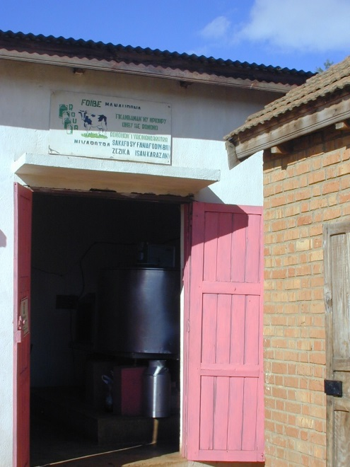
Your comments/ questions please?

